Slide 1
DSA (Data Structures and Algorithm) Project

Slide 2
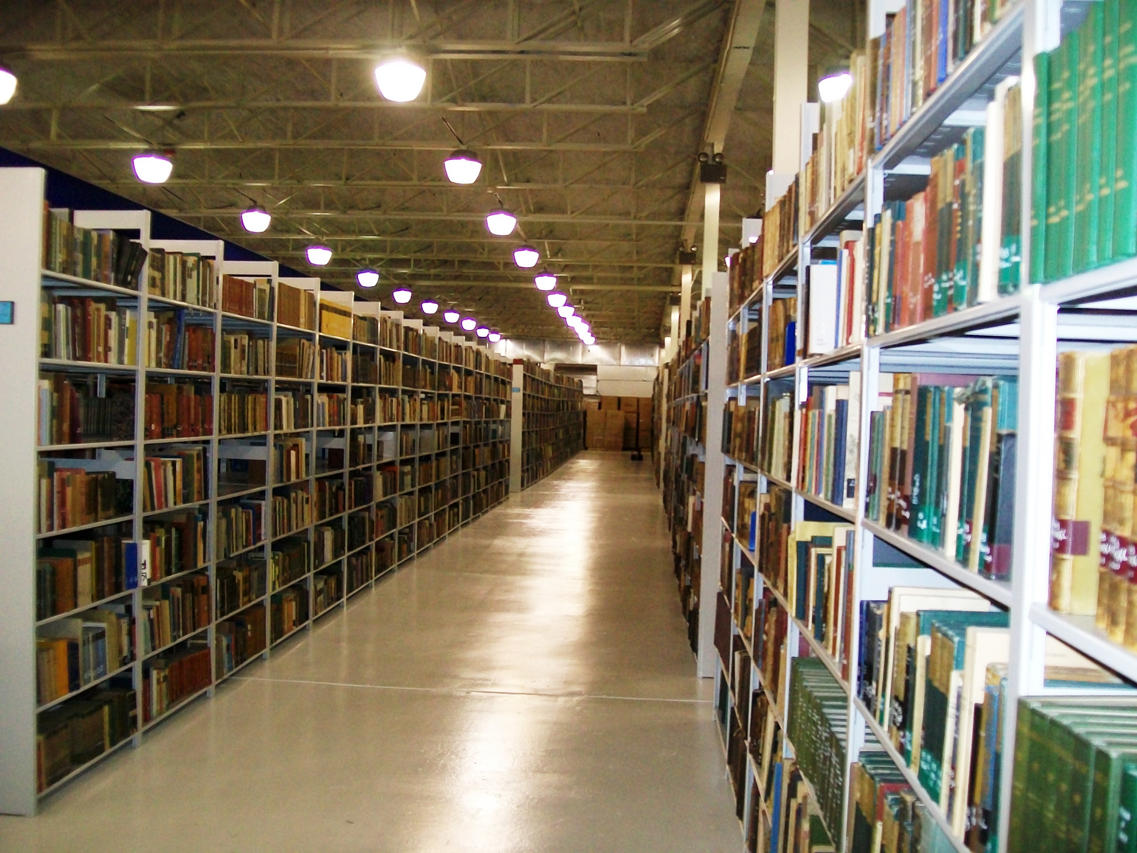
.
Project Title :
Student Library Management System

Slide 3
Details
Muhammad Samiullah
sami03496@gmail.com

Slide 4
Motivation and inspiration
My main motivation and inspiration was to implement Management System using Data structure(Linked List).
As my previous project of c language was also a management System so that’s what motivated me to find the difference in simple and Data structures implementation.

Slide 5
Functions
INITIALIZE LIBRARY (if not)
PRINT AVAILABLE BOOKS
ADD NEW BOOK TO LIBRARY STOCK
ISSSUE A BOOK
PRINT STUDENTS RECORD
RETURN BOOK IN LIBRARY
SEARCH BOOK RECORD
UPDATE BOOKS COPIES
DELETE BOOK RECORD

Slide 6
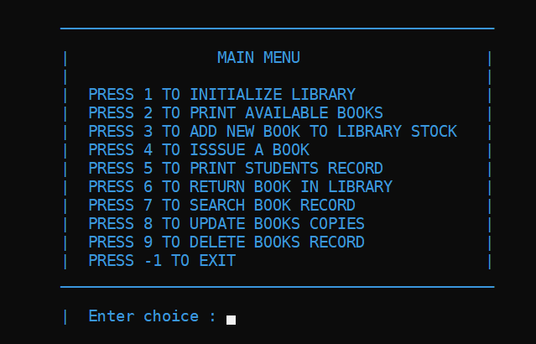
Main Menu

Slide 7
MAIN Features
It is a File supported Management System. Which means after terminating one time the data is not lost. Whenever we run the program the recently operated data is recovered.
Firstly the user can initialize the library with the number of books he/she wants. Else he/she can skip this step if there is already some books in the BooksDetails.txt File.
Then the user can print all the details of the books available in the stock. At the back end first I have defined Reading function which reads data from file and store this data in the Linked List. After that head of the Link List is passed to the printing function which prints all the data in the tabular Form and same is for students details to whom Books are issued .

Slide 8
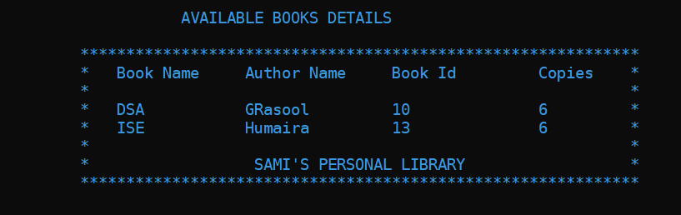
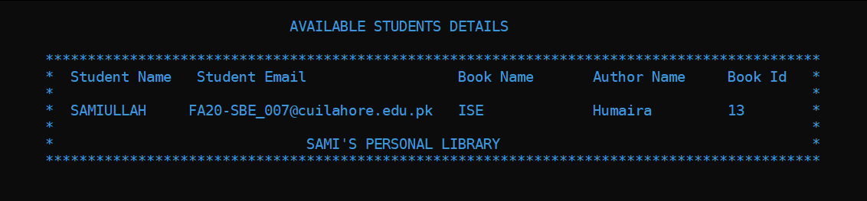

Slide 9
Main Features(cont...)
The user will be able to add One Book at a time after initialization and will also be able to delete One Book at a time.
The user will also be able to issue a Book if available and also to return book to the library stock and txt file will also restore this book details. If book is already in the stock then copies increase by 1 otherwise all the data is written with copies written as 1.
The user will also be able to search a book from the file which is stored in the pc memory.
It will also able the user to update the Book details. Here I have assumed that only Copies of the books are updated because if the user needs to change the Book name, etc. than the user can delete it first using delete option and then add new Book Details.

Slide 10
Appreciate If you like my Hard work
If any suggestions than please tell me because there always exist a space for improvement in every thing, as it is said that nothing is perfect and you learn it day by day.

Slide 11
Thank you

